Slide 1
Image Downloader Project
Philip Ishola, Shea Timmins, Zacharie Sauve, Collin Godsell
April 9th 2024

Slide 2

Introduction
Client: Tanya Lemieux, Natural Resources Canada’s Polar Continental Shelf Program (PCSP)
What they do: Coordinate logistical support and provide assistance to advance scientific knowledge of the Arctic region. They aim to contribute to Canada’s sovereignty over the Arctic region and its adjacent waters.
Client’s Vision: Develop a unified platform that consolidates all of their Arctic operational data, making it accessible through one interactive map. This is to enhance the efficiency and safety of the Arctic operations, given the region’s challenging weather conditions.

Slide 3
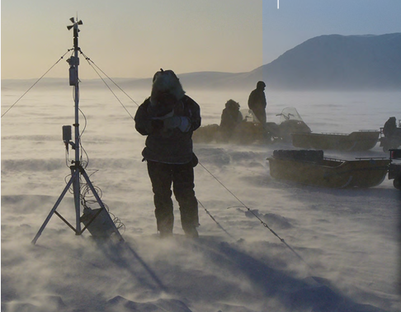
Project Purpose and Scope
The primary goal is to develop a tool that provides near-real-time satellite imagery of a specified area of interest to possibly support Arctic operations and research.
PCSP relies on NRT weather data to support operations and facilitate transportation. Retrieving accurate information at a specified location via KML is important for reaching the Client’s end vision.
The tool was developed in Python, and makes use of a few exterior tools such as Heg and Task Scheduler. The main goal of the tool is to retrieve the most recent images available for the user’s AOI.
Photo from PCSP’s Brochure chrome-extension://efaidnbmnnnibpcajpcglclefindmkaj/https://natural-resources.canada.ca/sites/nrcan/files/earthsciences/files/pdf/polar/PCSP-Brochure_eng.pdf

Slide 4
Client Requirements
Near Real Time Imagery of Site Location
Georeferenced
Multiple Bands (e.g True Colour, False Colour Composite, etc.)
KML(Z) File Format for Google Earth Pro
Interoperability, adaptability and integration to achieve end vision

Slide 5

Project Tools
Required Tools:
HEG Tool - A conversion tool developed by NASA for converting their HDF format to GeoTIFF
Task Scheduler - A tool that allows the user to run the script ‘behind the scenes’ for automation
Figure adapted from NASA’s HEG Service page, https://wiki.earthdata.nasa.gov/display/DAS/HEG%3A++HDF-EOS+to+GeoTIFF+Conversion+Tool

Slide 6
Project Workflow
Downloads Metadata TXT File
Aggregates Granule ID(s)
Begin
Downloads Corresponding HDF
HEG Converts Swath Into 3 GeoTIFF Files
Merges 3 Bands into 1 GeoTIFF
Converts the GeoTIFF to KMZ
Terminate

Slide 7
Challenges
Accessing NRT imagery using GIBS:
Initially we had tried using GIBS endpoint to grab imagery using WMS v 1.3.0
NASA’s documentation says NRT imagery is possible using this service but upon contact they direct us to LANCE
We used LANCE to grab metadata and corresponding HDF of the imagery
Distortion around the pole when processing Arctic Imagery
Imagery close to the North Pole causes an issue when selecting Swaths
The imagery shows up well, but the swath selected is not representative of the AOI because it is interrupted by the North Pole
Merging Bands
We experienced some confusion when merging the separate band tiff files
The bands derived from the HDF were encoded in 16 bit, when we needed 8 bit
Solution was to change the band image encoding

Slide 8
Results and Demonstration
The tool is not fully tested and debugged but still returns quality imagery of specified AOI
Relatively efficient process that reliably runs over long periods of time
Completely dependent on the efficiency of MODIS metadata updates
HDF files are not always complete (due to processing times, etc.) so a complete image with all bands is not always possible
Limited coverage due to only accessing one satellite
Results:

Slide 9
Further Improvements/Contributions
To expand coverage/data availability MODIS TERRA sensor could also easily be accessed through the TXT metadata file.
Other band combinations such as false color composite can be explored to get a different interpretation of the area of interest.
The process is redundant at times (5 minute interval) as it downloads the same HDF. To expand data coverage include TERRA, and increase time interval in scheduler.

Slide 10
Conclusion
We created a proof-of-concept tool that provides near-real-time satellite imagery of a specified area of interest in goal of supporting PCSP’s Arctic Logistics and Operations/Research
This tool is a step forward in developing a consolidated platform. With improvements to the data coverage and availability, this tool could be used to acquire NRT imagery and format it correctly
With data formatted as GeoTiff and KML, interoperability between softwares and platforms is reality. This tool enables the collection of NRT data to be integrated into a consolidated platform. An example use case is creating an interactive map that calls on data collected by the “ImageDownloader” Tool

Slide 11
Acknowledgements
We would like to acknowledge our Professor, Dr. Derek Mueller for his aide in advising the project and revising the code.
Questions?

